Slide 1
Data Science and Big Data Analytics Data Analytics Using R

Slide 2
Data Analytics Using R
This session has three sections
An overview of R
Using R to perform exploratory data analysis tasks using visualization
A brief review of statistical inference
Hypothesis testing and analysis of variance

Slide 3
Introduction to R
The first three phases involve in data analytics life cycle has various aspects of data exploration
In general, the success of a data analysis project requires a deep understanding of the data.
It also requires a toolbox for mining and presenting the data
These activities include the study of the data in terms of basic statistical measures and creation of graphs and plots to visualize and identify relationships and patterns.
There are many open or commercial tools for
Exploring
Conditioning
Modeling
Presenting data

Slide 4
Introduction to R
Generic R functions are functions that share the same name but behave differently depending on the type of arguments they receive (polymorphism)
Some important functions used in these concepts
head() displays first six records of a file
summary() generates descriptive statistics
plot() can generate a scatter plot of one variable against another
lm() applies a linear regression model between two variables
hist() generates a histogram
help() provides details of a function

Slide 5
Introduction to R
Example: 1.R

Slide 6
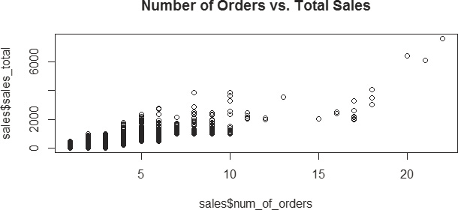
Introduction to R
Each point corresponds to the number of orders and the total sales for each customer
The plot indicates that the annual sales are proportional to the number of orders placed.
The observed relationship between these two variables is not purely linear, → analyst decided to apply linear regression → as a first step in the modeling process

Slide 7

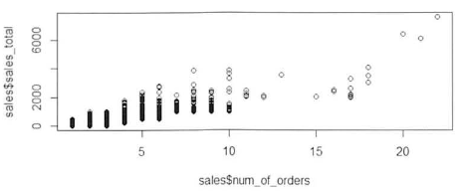
3.1 Introduction to R Example: number of orders vs sales
lm(formula = (sales$sales_total ~ sales$num_of_orders)
intercept = -154.1 slope = 166.2

Slide 8
Introduction to R
However, results stores considerably more information that can be examined with the summary() function.
Details on the contents of results are examined by applying the attributes() function.

Slide 9
Introduction to R
Data Import and Export
Example: 2.R

Slide 10
Contingency Table
table → it refers to a class of objects used to store the observed counts across the factors for a given dataset. → Contingency Table
It is basis for performing a statistical test on the independence of the factors used to build a table.

Slide 11
Contingency Table
Contingency Table
Example: 3.R few;;;;

Slide 12
Exploratory Data Analysis
Descriptive statistics functions in R helps us to get an idea of the magnitude and range of the data but other aspects such as linear relationships and distributions are more difficult to see from descriptive statistics.
A useful way to detect patterns and anomalies in the data is through the exploratory data analysis with visualization.
Visualization gives a succinct, holistic view of the data that may be difficult to grasp from the numbers and summaries alone.

Slide 13
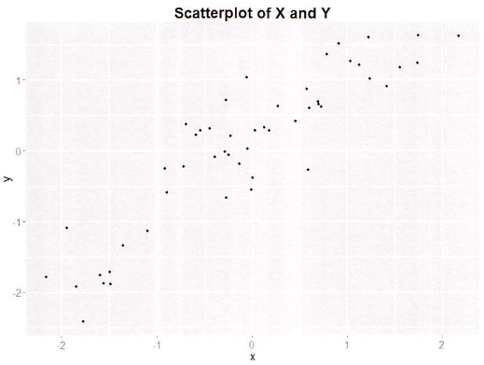
3.2 Exploratory Data Analysis Scatterplots show possible relationships
x <- rnorm(50) # default is mean=0, sd=1
y <- x + rnorm(50, mean=0, sd=0.5)
plot(y,x)

Slide 14
3.2 Exploratory Data Analysis
3.2.1 Visualization before Analysis
3.2.2 Dirty Data
3.2.3 Visualizing a Single Variable
3.2.4 Examining Multiple Variables
3.2.5 Data Exploration versus Presentation

Slide 15
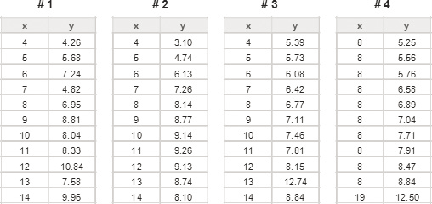
3.2.1 Visualization before Analysis Anscombe’s quartet – 4 datasets, same statistics

Slide 16
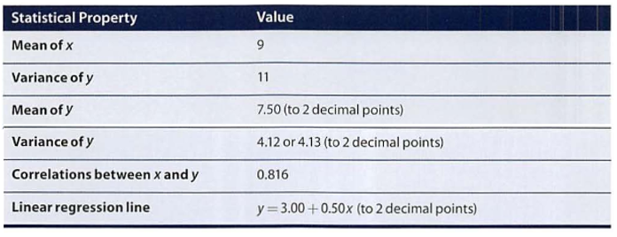
3.2.1 Visualization before Analysis Anscombe’s quartet – 4 datasets, same statistics
should be x

Slide 17
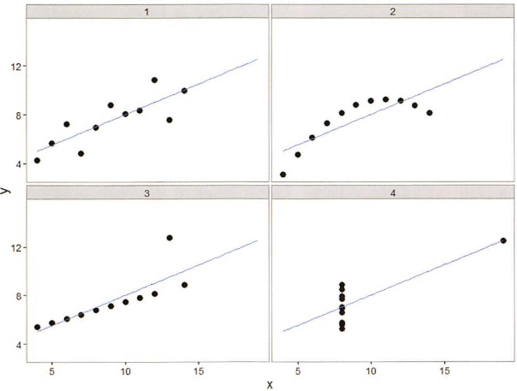
3.2.1 Visualization before Analysis Anscombe’s quartet – visualized

Slide 18
3.2.1 Visualization before Analysis Anscombe’s quartet – Rstudio exercise
)
Enter and plot Anscombe’s dataset #3
and obtain the linear regression line
More regression coming in chapter 6
x <- 4:14
x
y <- c(5.39,5.73,6.08,6.42,6.77,7.11,7.46,7.81,8.15,12.74,8.84)
y
summary(x)
var(x)
summary(y)
var(y)
plot(y~x)
lm(y~x)

Slide 19
3.2.2 Dirty Data
)
how dirty data can be detected in the data exploration phase with visualizations
In general, analysts should look for anomalies, verify the data with domain knowledge, and decide the most appropriate approach to clean the data.
Consider a scenario in which a bank is conducting data analyses of its account holders to gauge customer retention

Slide 20
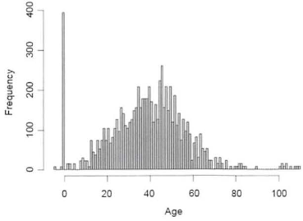
3.2.2 Dirty Data Age Distribution of bank account holders
What is wrong here?

Slide 21
3.2.2 Dirty Data
)
the median age of the account holders is around 40.
A few accounts with account holder age less than 10 are unusual but plausible. → ok
However, the left side of the graph shows a huge spike of customers who are zero years old or have negative ages → evidence of missing data
One possible explanation is that the null age values could have been replaced by 0 or negative values during the data input
Such an occurrence may be caused by entering age in a text box that only allows numbers and does not accept empty values.
Therefore, data cleansing needs to be performed over the accounts with abnormal age values

Slide 22
3.2.2 Dirty Data
)
Account holders older than 100 may be due to bad data caused by typos.
In this case, one needs to further examine the data and conduct data cleansing if necessary.
The dirty data could be simply removed or filtered out with an age threshold for future analyses.
If removing records is not an option, the analysts can look for patterns within the data and develop a set of heuristics to attack the problem of dirty data.
For example, wrong age values could be replaced with approximation based on the nearest neighbor

Slide 23
3.2.2 Dirty Data
)
In the following figure, it presents another example of dirty data
The distribution shown here corresponds to the age of mortgages in a bank’s home loan portfolio.
The mortgage age is calculated by subtracting the origination date of the loan from the current date.
The vertical axis corresponds to the number of mortgages at each mortgage age.
The 10 in the x-axis actually means ≥ 10.
Analysts need to study the data further and decide the most appropriate way to perform data cleansing.
Data analysts should perform sanity checks against domain knowledge and decide if the dirty data needs to be eliminated.
Dirty data can occur due to acts of omission.

Slide 24
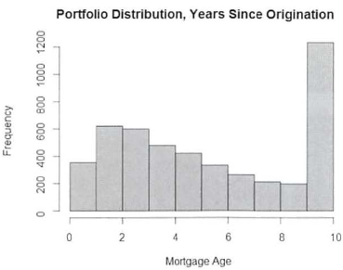
3.2.2 Dirty Data Age of Mortgage
What is wrong here?

Slide 25
Visualizing a Single Variable
)
Using visual representations of data is a hallmark of exploratory data analyses:
letting the data speak to its audience rather than imposing an interpretation on the data a priori.
Visualizing a single variable and examining multiple variables helps to explain the underlying distributions of a single variable or the relationships of two or more variables.
R has many functions to examine a single variable. Some of them are listed in the next slide.

Slide 26
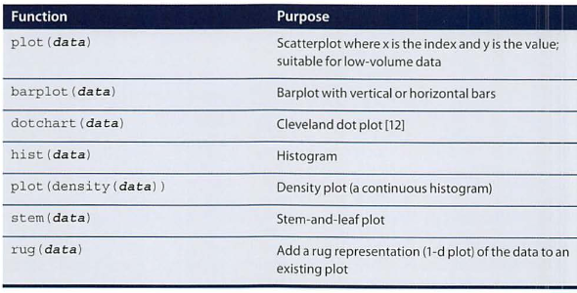
Visualizing a Single Variable

Slide 27
Visualizing a Single Variable
)
Plot() in R:
Generic function for plotting of R objects.
Usage:
plot(x, y, ...)
Where x → the coordinates of points in the plot.
Y → the y coordinates of points in the plot, optional if x is an appropriate structure.
Type → possible types are → “p” for points, “l” for lines, “b” for both, “c” for the lines part alone of “b”, “o” for both ‘overplotted’, “h” for histogram, “s” for strips, “S” for other steps, and “n” for no plotting
Main → an overall title of the plot
Sub → a sub title of the plot
Xlab → a title for the x-axis
Ylab → a title for the y-axis
Asp → the y/x aspect ratio

Slide 28
Visualizing a Single Variable
)
Plot() in R:
Example: Pending

Slide 29
Visualizing a Single Variable
)
Barplot() :
barplot portray continuous values with labels from a discrete variable.
A barplot can be created with the barplot(height) function, where height represents a vector or matrix.
R-Code for Barplot() on mtcars:
Barplot for distribution of cars cylinders counts
data(mtcars)
View(mtcars)
summary(mtcars)
head(mtcars)
barplot(table(mtcars$cyl), main="Distribution of Car Cylinder Counts", xlab="Number of Cylinders")

Slide 30
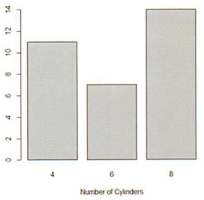
Visualizing a Single Variable Barplot – Distribution of Car Cylinder Counts

Slide 31
Visualizing a Single Variable
)
Dotchart() :
It aslo portray continuous values with labels from a discrete variable.
A Dotchart can be created with dotchart(x,label=…) function, where x is a numeric value and label is a vector of categorical labels for x.
R-Code for Barplot() on mtcars:
Dotchart() for Miles per Gallons(MPG) of Car Models
data(mtcars)
View(mtcars)
summary(mtcars)
head(mtcars)
dotchart(mtcars$mpg,labels=row.names(mtcars),cex=.7, main="Miles Per Gallon (MPG) of Car Models", xlab="MPG")

Slide 32
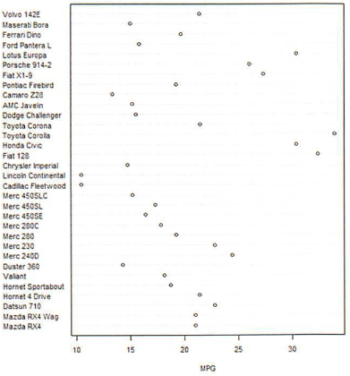
Visualizing a Single Variable Dotchart – MPG of Car Models

Slide 33
Visualizing a Single Variable
)
Histogram():
The generic function hist computes a histogram of the given data values.
R-Code for histogram() on household income:
# randomly generate 4000 observations from the log normal distribution
income <- rlnorm(4000, meanlog = 4, sdlog = 0.7)
summary(income)
income <- 1000*income
summary(income)
hist(income, breaks=500, xlab="Income", main="Histogram of Income")

Slide 34
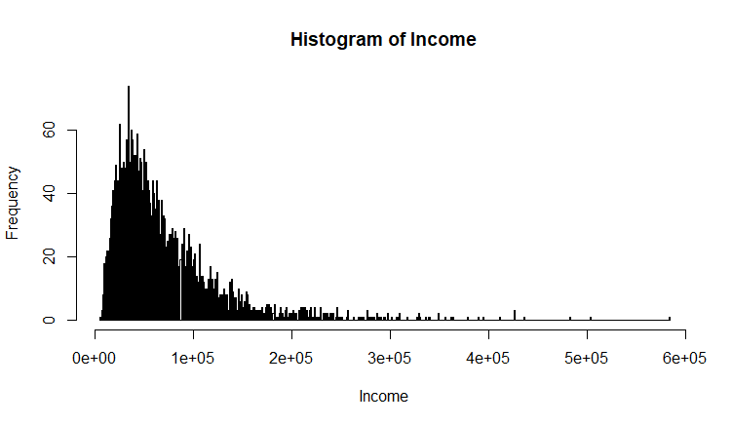
Visualizing a Single Variable Histogram – Income

Slide 35
Visualizing a Single Variable
)
Densityplot():
Distribution of values
The income distribution is concentrated in the center portion of the graph
The rug() function creates a one-dimensional density plot on the bottom of the graph to emphasize the distribution of the observation.
R-Code for densityplot() on household income:
income <- rlnorm(4000, meanlog = 4, sdlog = 0.7)
income <- 1000*income
plot(density(log10(income), adjust=0.5), main="Distribution of Income (log10 scale)")
rug(log10(income))

Slide 36
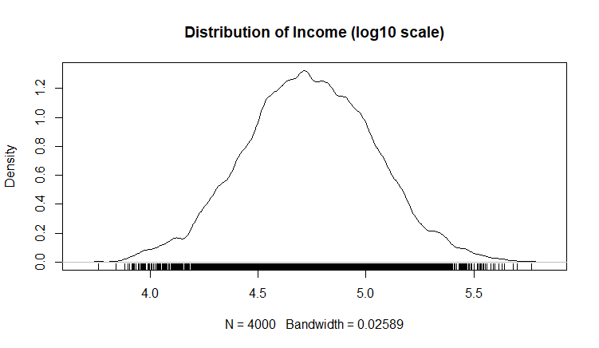
Visualizing a Single Variable Density – Income (log10 scale)

Slide 37
Visualizing a Single Variable Density – Income (log10 scale)
In this case, the log density plot emphasizes the log nature of the distribution
The rug() function at the bottom creates a one-dimensional density plot to emphasize the distribution

Slide 38
Visualizing a Single Variable
)
In the data preparation phase of the Data Analytics Lifecycle, the data range and distribution can be obtained.
If the data is skewed, viewing the logarithm of the data can help detect structures that might otherwise be overlooked in a graph with a regular, non-logarithmic scale
When preparing the data, one should look for signs of dirty data.
Examining if the data is unimodal or multimodal will give an idea of how many distinct populations with different behavior patterns might be mixed into the overall population.
Many modeling techniques assume that the data follows a normal distribution.

Slide 39
Visualizing a Single Variable
)
Consider a density plot of diamond prices (in USD).
The next consists of two density plots for premium and ideal cuts of diamonds.
One group of premium cuts is shown in red.
Another group of ideal cuts is shown in blue.
The range of diamond prices is wide—in this case ranging from around $300 to almost $20,000.
Extreme values are typical of monetary data such as income, customer value, tax liabilities, and bank account sizes.
The Righthand side figures shows more detail of the diamond prices than lefthand side figure by taking the logarithm.
The two humps in the premium cut represent two distinct groups of diamond prices

Slide 40
Visualizing a Single Variable
)
The two humps in the premium cut represent two distinct groups of diamond prices:
One group centers around log₁₀ price=2.9 (where the price is about $794).
The other centers around log . 10 price=3 7 (where the price is about $5,012).
The ideal cut contains three humps centering around 2.9, 3.3, and 3.7 respectively.
R-Code:
Diamonds1.R

Slide 41
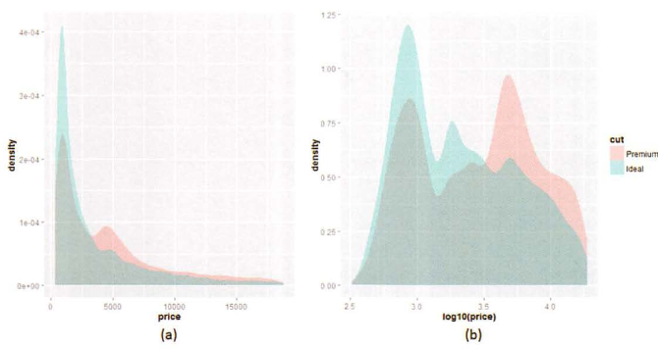
Visualizing a Single Variable Density plots – Diamond prices, log of same

Slide 42
Examining Multiple Variables
)
A scatterplot is a simple and widely used visualization for finding the relationship among multiple variables.
A scatterplot can represent data with up to five variables using x-axis, y-axis, size, color, and shape.
But usually only two to four variables are portrayed in a scatterplot to minimize confusion.
Close attention is required while examing the possible relationship among the variables.
If the functional relationship between the variables is somewhat pronounced, the data may roughly lie along a straight line, a parabola, or an exponential curve.
If variable y is related exponentially to x, then the plot of x versus log(y) is approximately linear.

Slide 43
Examining Multiple Variables
)
If the plot looks more like a cluster without a pattern, the corresponding variables may have a weak relationship.

Slide 44
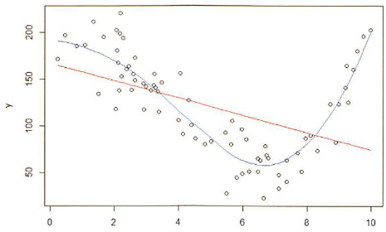
3.2.4 Examining Multiple Variables Examining two variables with regression
Red line = linear regression
Blue line = LOESS curve fit
x

Slide 45
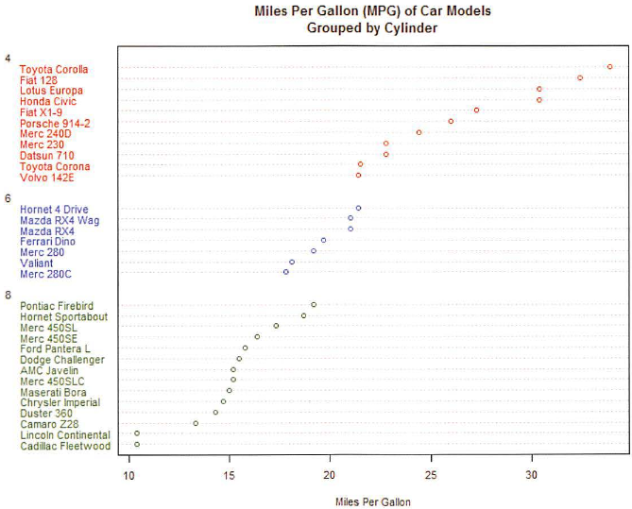
3.2.4 Examining Multiple Variables Dotchart: MPG of car models grouped by cylinder

Slide 46
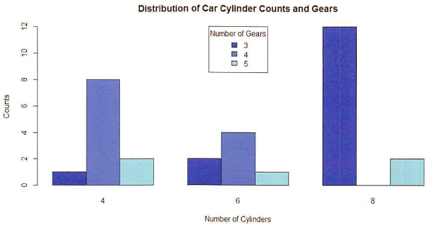
3.2.4 Examining Multiple Variables Barplot: visualize multiple variables

Slide 47
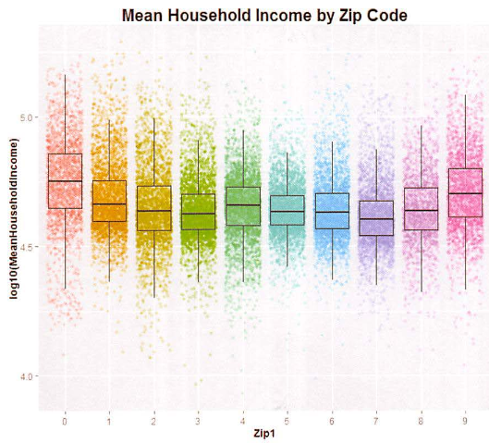
3.2.4 Examining Multiple Variables Box-and-whisker plot: income versus region
Box contains central 50% of data
Line inside box is median value
Shows data quartiles

Slide 48
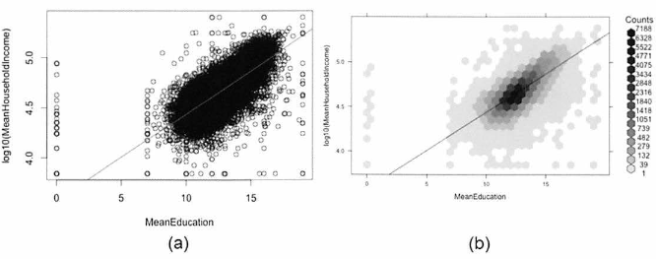
3.2.4 Examining Multiple Variables Scatterplot (a) & Hexbinplot – income vs education
The hexbinplot combines the ideas of scatterplot and histogram
For high volume data hexbinplot may be better than scatterplot

Slide 49
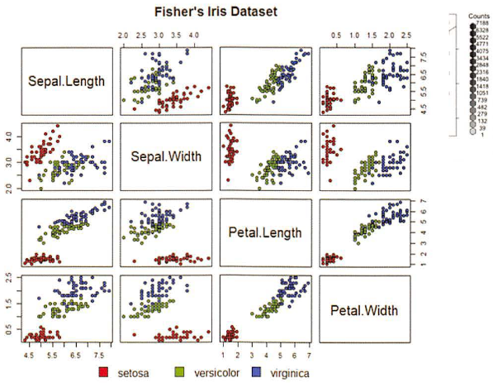
3.2.4 Examining Multiple Variables Matrix of Scatterplots

Slide 50
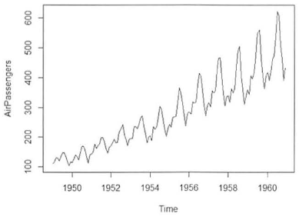
3.2.4 Examining Multiple Variables Variable over time – airline passenger counts

Slide 51
3.2.5 Exploration vs Presentation
Data visualization for data exploration is different from presenting results to stakeholders
Data scientists prefer graphs that are technical in nature
Nontechnical stakeholders prefer simple, clear graphics that focus on the message rather than the data

Slide 52
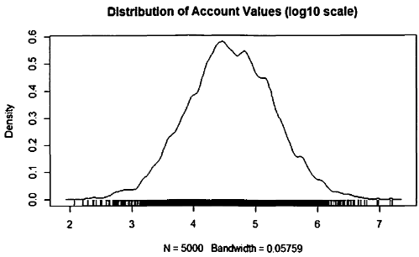
3.2.5 Exploration vs Presentation Density plots better for data scientists

Slide 53
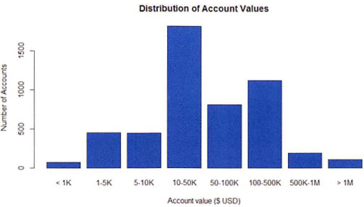
3.2.5 Exploration vs Presentation Histograms better to show stakeholders

Slide 54
Statistical Methods for Evaluation
Visualization is useful for data exploration and presentation, but statistics is crucial because it may exist throughout the entire Data Analytics Lifecycle.
Statistical techniques are used during
data exploration and data preparation
model building
evaluation of the final models and
assessment of how the new models improve the situation when deployed in the field.

Slide 55
Statistical Methods for Evaluation Statistics helps answer data analytics questions
Model Building
What are the best input variables for the model?
Can the model predict the outcome given the input?
Model Evaluation
Is the model accurate?
Does the model perform better than an obvious guess?
Does the model perform better than other models?
Model Deployment
Is the prediction sound?
Does model have the desired effect (e.g., reducing cost)?

Slide 56
Statistical Methods for Evaluation Subsections
3.3.1 Hypothesis Testing
3.3.2 Difference of Means
3.3.3 Wilcoxon Rank-Sum Test
3.3.4 Type I and Type II Errors
3.3.5 Power and Sample Size
3.3.6 ANOVA (Analysis of Variance)

Slide 57
Hypothesis Testing
When comparing populations, such as testing or evaluating the difference of the means from two samples of data, a common technique to assess the difference or the significance of the difference is hypothesis testing.
The Basic concept of hypothesis testing is to form an assertion and test it with data.
Common assumption is that there is no difference between samples (default assumption)
Statisticians refer to this as the null hypothesis (H₀)
The alternative hypothesis (H_{A}) is that there is a difference between samples.

Slide 58
Hypothesis Testing
Example-1: if the task is to identify the effect of drug A compared to drug B on patients, the null hypothesis and alternative hypothesis would be this.
H₀ : Drug A and drug B have the same effect on patients.
H_{A} : Drug A has a greater effect than drug B on patients.
Example – 2: If the task is to identify whether advertising Campaign C is effective on reducing customer churn, the null hypothesis and alternative hypothesis would be as follows.
H₀ : Campaign C does not reduce customer churn better than the current campaign method
H_{A} : Campaign C does reduce customer churn better than the current campaign.

Slide 59
Hypothesis Testing
It is important to state the null hypothesis and alternative hypothesis, because misstating them is likely to undermine the subsequent steps of the hypothesis testing process.
A hypothesis test leads to either rejecting the null hypothesis in favor of the alternative or not rejecting the null hypothesis.

Slide 60
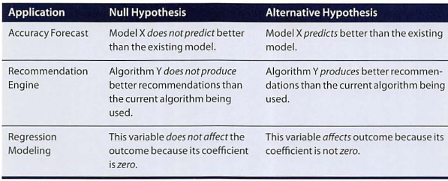
Hypothesis Testing

Slide 61
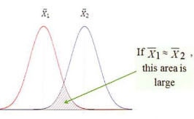
3.3.2 Difference of Means Two populations – same or different?

Slide 62
3.3.2 Difference of Means Two Parametric Methods
Student’s t-test
Assumes two normally distributed populations, and that they have equal variance
Welch’s t-test
Assumes two normally distributed populations, and they don’t necessarily have equal variance

Slide 63
3.3.3 Wilcoxon Rank-Sum Test A Nonparametric Method
Makes no assumptions about the underlying probability distributions

Slide 64
3.3.4 Type I and Type II Errors
An hypothesis test may result in two types of errors
Type I error – rejection of the null hypothesis when the null hypothesis is TRUE
Type II error – acceptance of the null hypothesis when the null hypothesis is FALSE

Slide 65
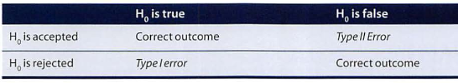
3.3.4 Type I and Type II Errors

Slide 66
3.3.5 Power and Sample Size
The power of a test is the probability of correctly rejecting the null hypothesis
The power of a test increases as the sample size increases
Effect size δ = difference between the means
It is important to consider an appropriate effect size for the problem at hand

Slide 67
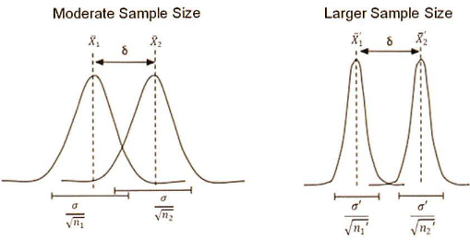
3.3.5 Power and Sample Size

Slide 68
3.3.6 ANOVA (Analysis of Variance)
A generalization of the hypothesis testing of the difference of two population means
Good for analyzing more than two populations
ANOVA tests if any of the population means differ from the other population means

